Slide 1
Identifying Pneumonia Diagnosis by Image-Based Deep Learning (?)
Faber Silitonga - faber.yosua@gmail.com - abrosua
Fikhri Masri - masrifikhri@gmail.com - fikhrimasri
Dimas Anom Priyayi - priyayidimas@gmail.com - priyayidimas
Source Dataset : https://www.kaggle.com/paultimothymooney/chest-xray-pneumonia

Slide 2
Dataset Metadata
Citation | http://www.cell.com/cell/fulltext/S0092-8674(18)30154-5
Usage Information | License | CC BY 4.0
 | Visibility | Public
Maintainer | Dataset Owner | Paul Mooney
Updates | Last Updated | 2018-03-25 (Version 2)
 | Created Date | 2018-03-22
Dataset | Train | Normal: 1341 images; Pneumonia: 3875 images
 | Validation | Normal: 8 images; Pneumonia: 8 images
 | Test | Normal: 234 images; Pneumonia: 390 images

Slide 3
Problem Framing → Binary Classification
By using image classification to determine whether someone has pneumonia or not from the x-ray image of the lungs, we can probably speed the diagnosis process, thus helping the medical center works efficiently.
The output labels would be “normal” or “pneumonia”.
The success rate of this model depends on precision and recall rate of the model. The model is presumed success if precision rate is over 90% and recall rate is over 95%.

Slide 4
Preparation
Hyperparameters to be tuned:
Network architecture
Optimizer method
Adam or RMSProp
Initial learning rate value
1e-4, 5e-5 or 1e-5
LR Scheduler (ReduceLROnPlateau) factor value
0.2 or 0.5
Data Preprocessing (Image augmentation):
Pixel value rescaling
Rotation : -5 to 5 degree
Width shift : -0.1 to 0.1
Height shift : -0.05 to 0.05
Shear : -0.1 to 0.1
Zoom : -0.15 to 0.15
Horizontal flipping

Slide 5
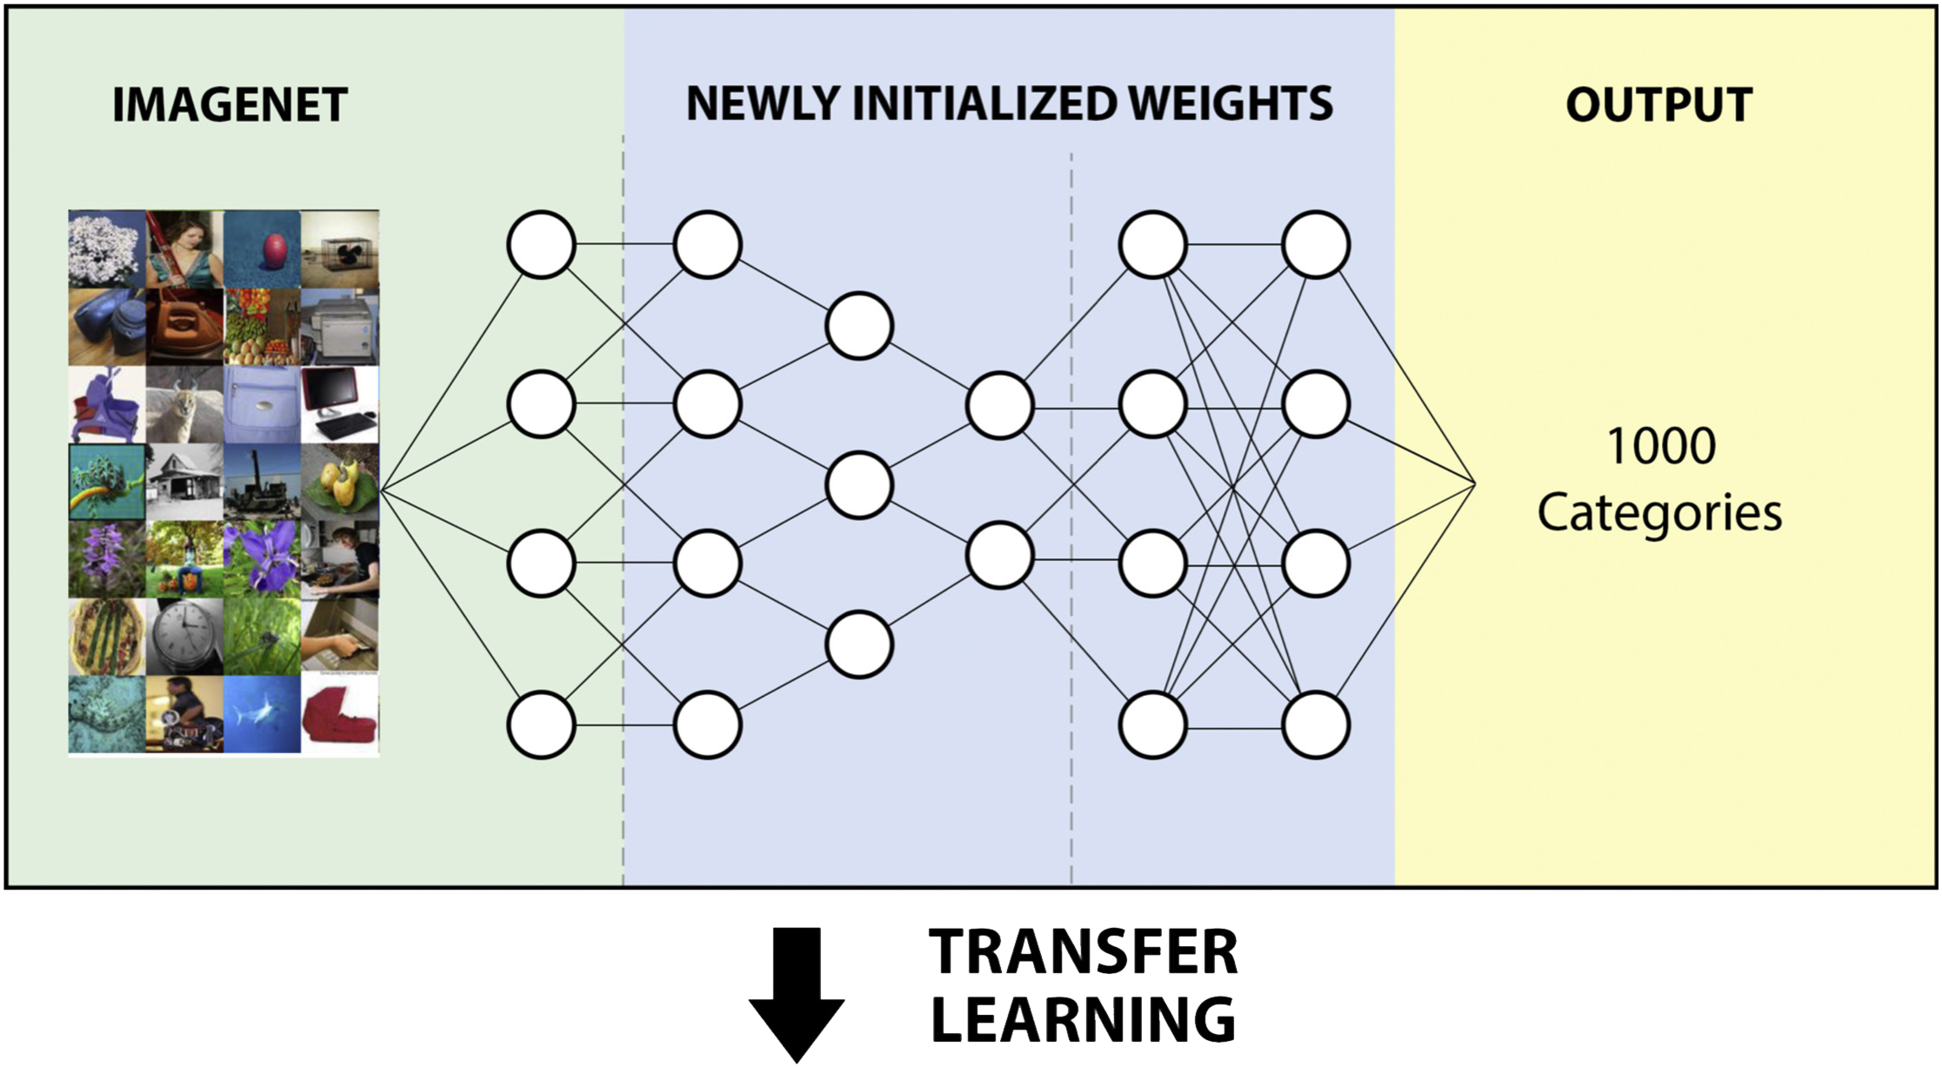
Technique → Neural Network, Deep Transfer learning

Slide 6
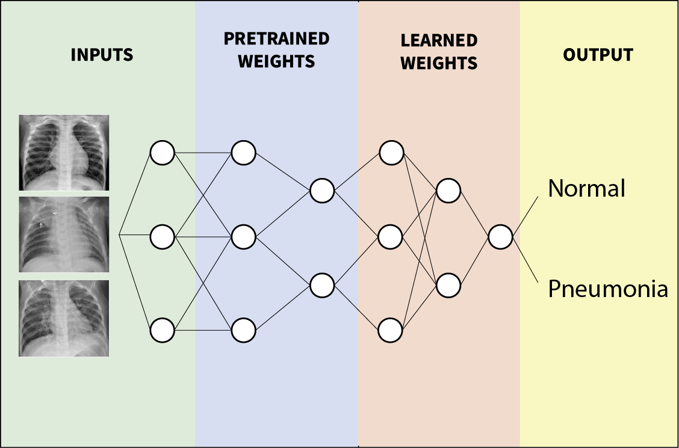
Technique → Neural Network, Deep Transfer learning
(Using XCeption and ResNet)

Slide 7
Result and Conclusion
(XCeption and ResNet ?)

